Slide 1
GROUP PROJECT #1 CSIS3280 WEB SCRIPTING
300234287 Matthew Dyrndahl
300303595 Tsz Yang Wong
300296183 Hyewon Joo

Slide 2
Project Description
In this paper we will describe the proposal for our group project, which includes both the function of our web application and the entities which our web app will use. We will be coding a shopping cart web application that makes use of PHP, PDO and a mysql database in order to have a functional internet shopping service. Our application will initially display a user login page, in which the user has the option of logging in, creating a new username / password combination or deleting an existing user. Once the user has logged in, the user will have the option of placing an order or viewing current and past orders. If the username and password are incorrect, the user will be prompted and reminded to insert a correct username and password. When the user chooses to view the place an order page, the user will be able to search for items, to add items which are in stock to their shopping cart, to place an order and to modify the stores currently available items using a create or delete item function; if the item is already within the stock of the shopping cart database, the user will be prompted by a notice which tells the user that the item is already in stock. In the current and past orders page, the user will be able to update or delete any orders which have been placed. The three main entities that our web application will use are user, items, and payment method. The user entity will have username and password properties in order to login, and an order property which allows the user to view any orders which have been placed. The item entity will be a simple entity swhich is able to be added to the shopping cart of the user. Finally, the order entity will have two properties, one which identifies the user in ownership of the order and another items property which contains the items present within the order. We will all work together on the functionality, but Matt will be primarily working on the user entity, Tsz will work on the item entity and Hyewon will work on the payment entity. We will be attempting to integrate our web application with the REST API web service.

Slide 3
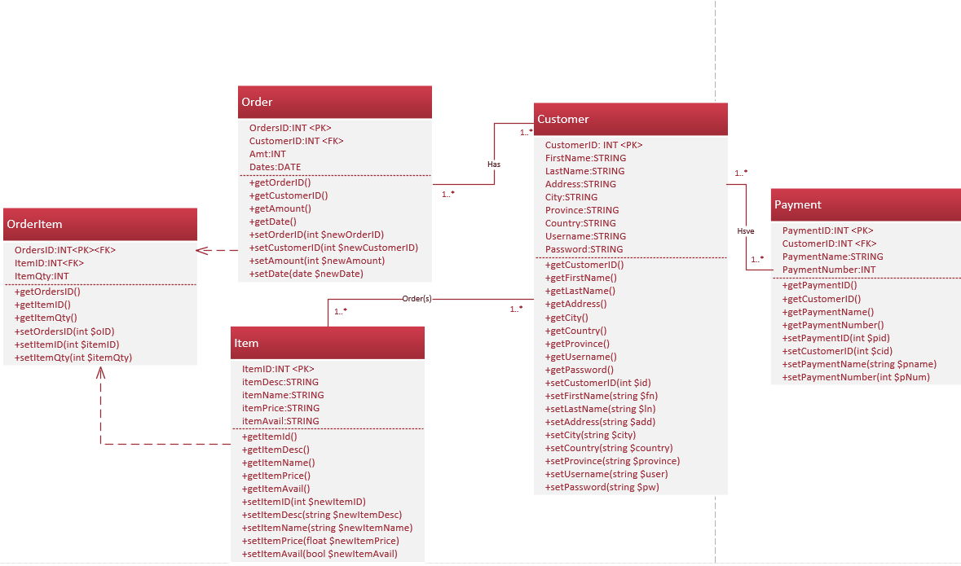
Class Diagram

Slide 4
Meeting details
Meeting minutes & Attendance
3/28/2019 <20 min> : Plan meetings <ALL>
3/30/2019 <5 hours> : Create classes & SQL & login-out function <ALL>
4/2/2019 <3 hours> : Create mappers (CRUD) & Class diagram <ALL>
4/3/2019 <7 hours> : Rest API <ALL>

Slide 5
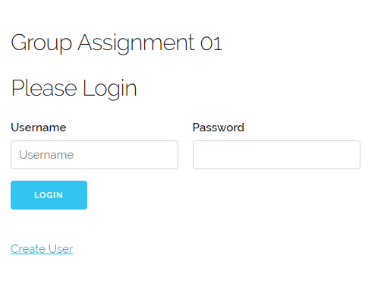
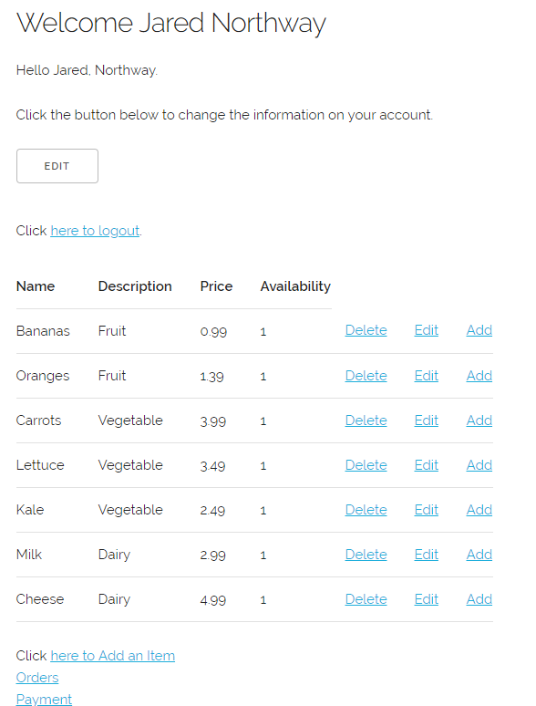
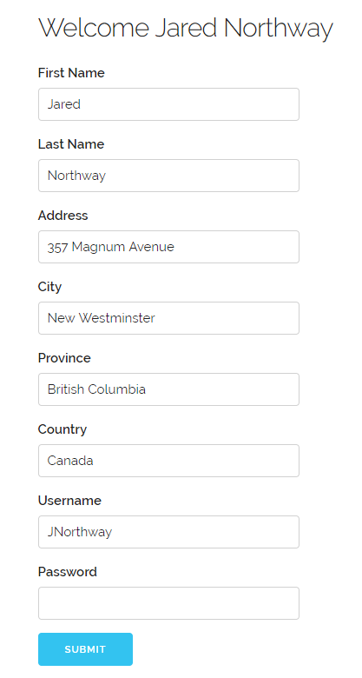
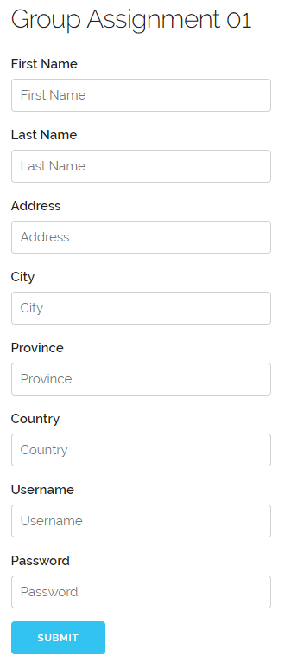
User Manual
If login is successful,
it shows a welcome page and lists of items.
User can delete, edit item.
Click ’ Add’ to add items to order
Press ‘EDIT’ button to edit user’s account
Enter username and password to login
Or click ‘Create User’ button
to create new account.

Slide 6
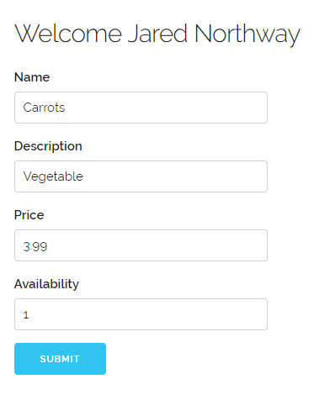
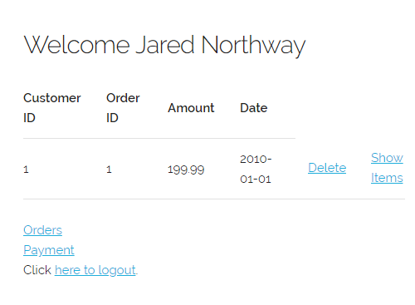
Click ‘orders’ to show orders for the specific customer
Click ‘Delete’ to delete an order
Edit an item

Slide 7
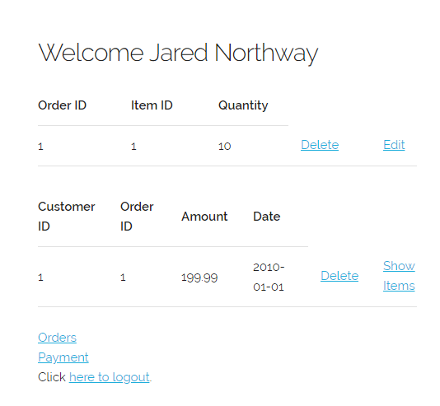
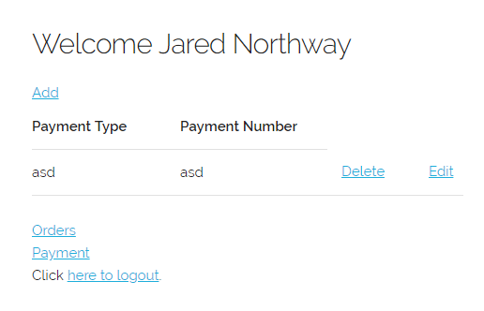
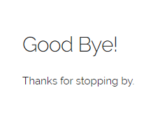
Click ‘Payment’ to show payment option
for the specific customer
Click ‘Show Items’ to see items in the order
Click ‘Edit’ to edit items
Click ‘Add’ to add payment option
Click ‘here to logout’ to log out

Slide 8
References
CSIS3280Week12DemoCode

